Slide 1
Travel route suggestion based on pattern of travel and difficulties
Group members:
Supriti Mondal (CSE-DS/2021/015)
Amrita Mondal(CSE-DS/2021/018)
Sanchita Sarkar(CSE-DS/2021/008)
Siddhartha Shaw(CSE-DS/2021/003)
Guided by:
Prof. Manali Sarkar

Slide 2
CONTENT:
Introduction
Comparison
Literature Survey
Overcoming travel difficulties
Future scope
References

Slide 3
Introduction:
The main objective of the project is to help visitors travelling from their source to destination with best possible route.
The project suggest the best route/destination for travelers from the feedback, this system will also guide the visitors for the good travel routes and destinations.
The project learn from traveler experiences and use this information in guiding future travelers to tell which route will be preferable for them.

Slide 4
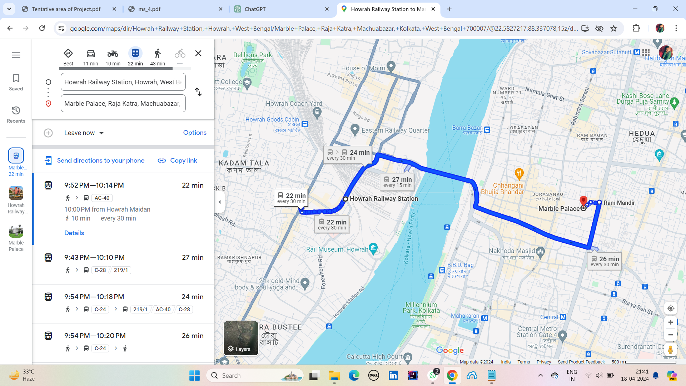
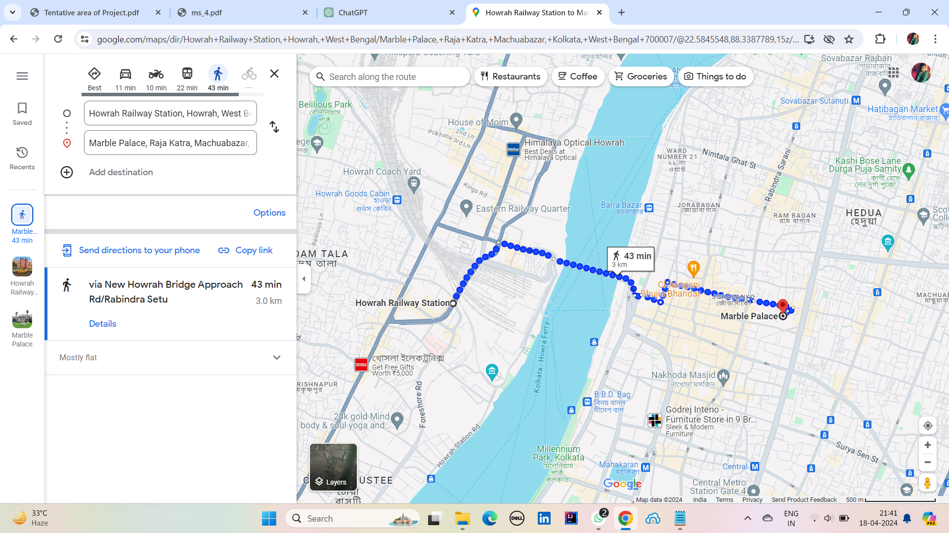
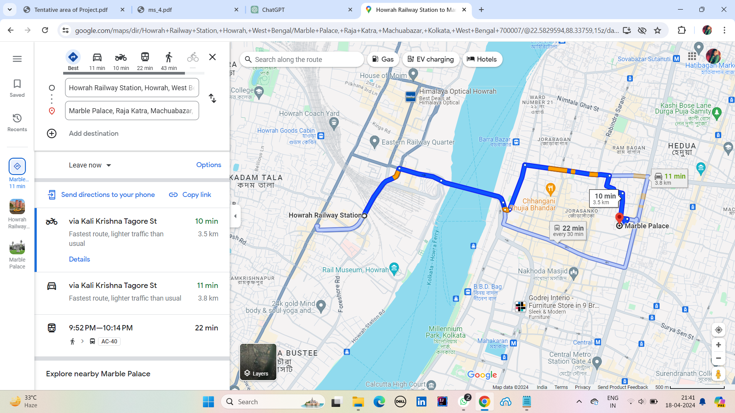
COMPARISON

Slide 5
Literature Survey
Logesh Ravi and Subramaniyaswamy Vairavasundaram details a development of recommender systems based on travelers interests. Social data such as check-in behavior, social relationships, ratings, and recent area of work helps in the discovery of very accurate travel recommendations. Authors proposes a location recommender system comprising of four major components: UI module, recommendation module, ratings prediction module, and location based social network.
Ge Cui et al. proposes two personalized travel route recommendation methods – collaborative travel route recommendation (CTRR) and an extended version of CTRR. Both methods uses personalized travel routes followed by users based on GPS. Users travel behaviour frequencies are estimated by using collaborative filtering technique and then improved to get maximum probability of a route using Naive Bayes model.
An-Jung Cheng et al. proposes travel route recommendation based on peoples attributes from photos like: gender, age, race. Authors find that people attributes are effective for making decisions on travel landmarks and paths and also helpful for route planning and personalized travel recommendation.
.

Slide 6
Overcoming Travel Difficulties:
Identifies potential challenges based on your route offers solutions and resources to overcome them language barriers.
Travel isn’t always smooth due to transportation issues.
Pattern-based travel route planning not only suggests destinations but also identifies potential challenges like language barriers, transportation issues along your chosen route.

Slide 7
Future Scope
Develop a personalized travel recommendation model using probabilistic techniques.
Use travelers attribute to identify popular travel landmarks and paths.
Improve travel recommendation system and route plaining for the users.
Analyze travel photo logs and detect people attributes from photo content to inform recommendations.
Reference
Nikhitha Pulmamidi, Rajanikanth Aluvalu and V Uma Maheswari, "Intelligent Travel Route Suggestion System Based on Pattern of Travel And Difficulties", IOP Conference Series:Materials Science and Engineering, vol. 1042, 13 pages, 2020.
Logesh Ravi, Subramaniyaswamy Vairavasundaram, "A Collaborative Location Based Travel Recommendation System through Enhanced Rating Prediction for the Group of Users", Computational Intelligence and Neuroscience, vol. 2016, Article ID 1291358, 28 pages, 2016.

Slide 8
THANK Y☺U!

